Slide 1
University of Alaska Fairbanks Office of Admissions uaf-admission@alaska.edu

Slide 2
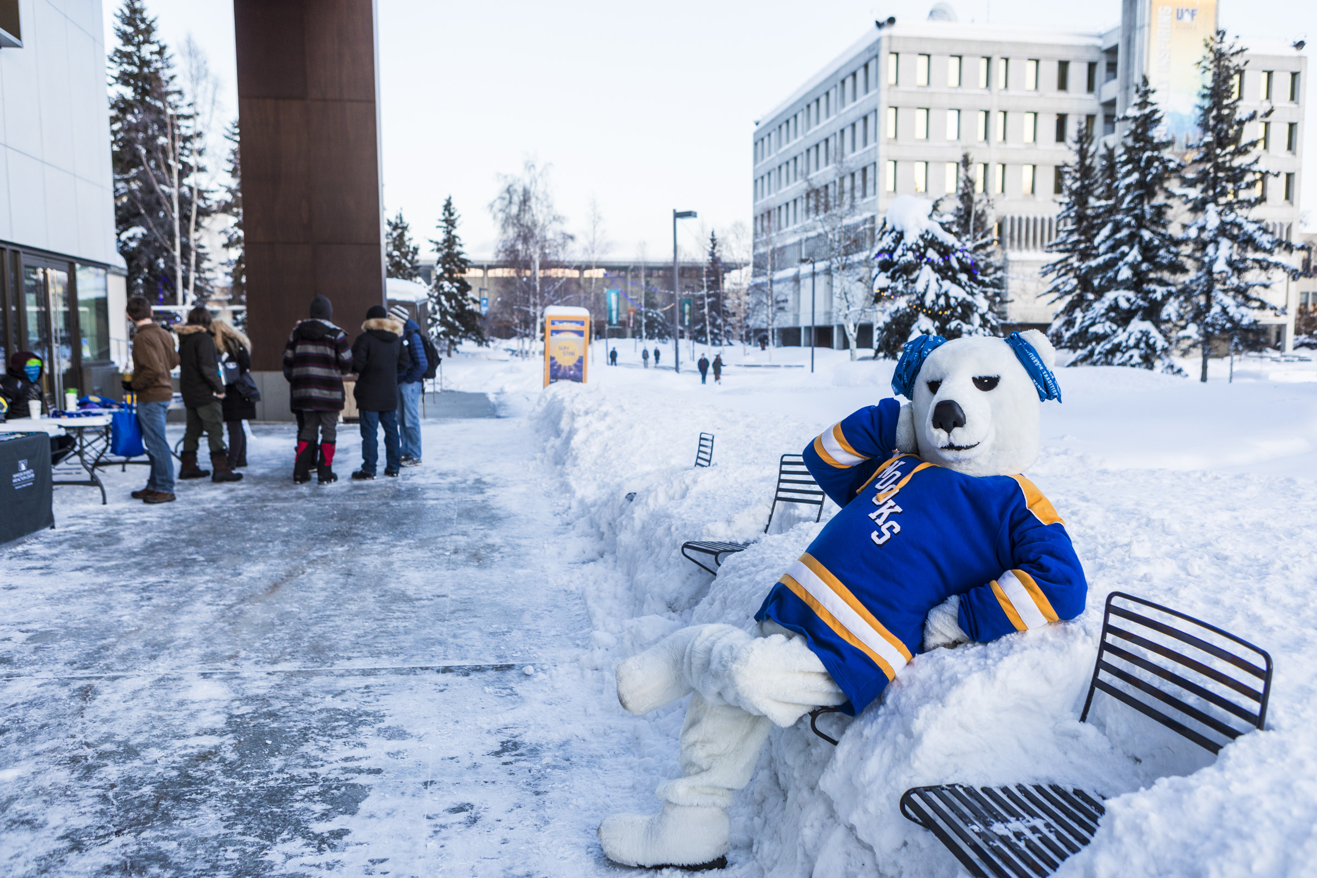
QUICK FACTS
Year established: 1917
Total enrollment: 8,720 Fairbanks campus: 5,667
Student-faculty ratio: 11 to 1
Size of Fairbanks campus: 2,250 acres
Top five home states of all undergrad students: Alaska, Washington, California, Florida, Texas
Student clubs: 140+
Mammoth tusks buried somewhere on Fairbanks campus in 1938: 30
Oddly large number of Thai restaurants in Fairbanks: 15, at last count

Slide 3
World leader in climate change and Arctic research.
Receives over 100 million dollars in research funding annually – this is unique given that we only have 5,667 students on the Fairbanks campus.
Alaska’s only Land, Sea and Space Grant University.
Provides hands-on learning experience in the vast, dynamic laboratory that is Alaska.

Slide 4
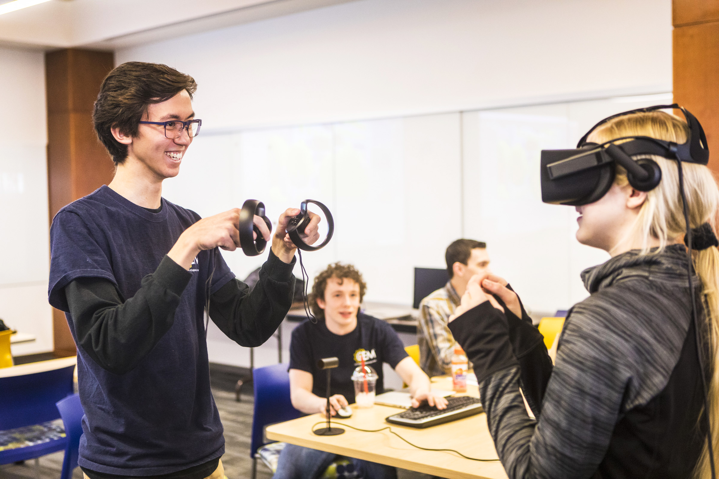
Tristan Van Cise helped UAF’s cyber security team win a regional contest and take second in one event at the nationals in Florida. Van Cise, a computer science major from Sitka, enjoys UAF’s small program and the close-knit cyber security team. “You get to know each other and it’s good having that team dynamic, trusting your team’s competence. It’s been a lot of fun,” he said.

Slide 5
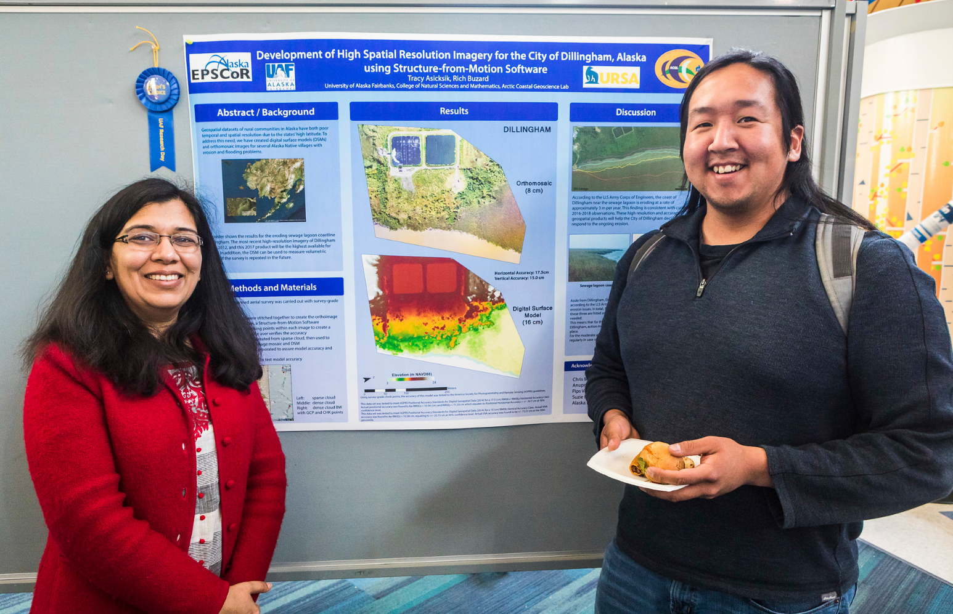
Undergraduate Research and Scholarly Activity
URSA
In 2017, awarded ~$300K for:
students to conduct research
students to pursue creative activities
students to travel to present work at professional meetings
faculty to develop and implement opportunities for research.
41% of all students at UAF participate in research or creative activities during their time at UAF.

Slide 6
HONORS PROGRAM
“What a terrific opportunity Honors presents to gain unique access to community and tight knit cohort culture amongst likeminded students from all over campus. Often, what attracts students to honors is how good it looks on a resume, but I would also point to the intensive advising, travel, favorable student-to-faculty ratios and scholarship opportunities.”
– Alexander Hirsch, Director, Honors Program

Slide 7
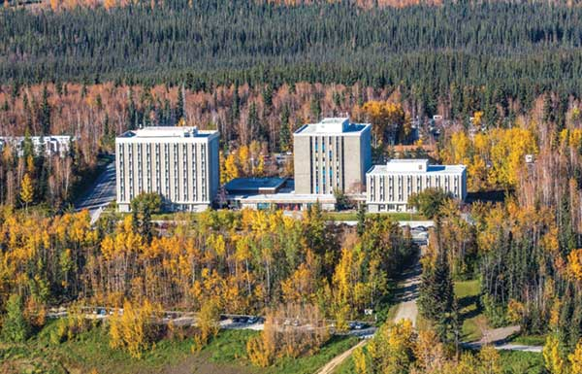
Housing for traditional students, graduate and non-traditional students, families as well as staff and faculty
Residence Life sponsors about 600 social activities each year, so there’s always something going on.
RESIDENCE LIFE

Slide 8
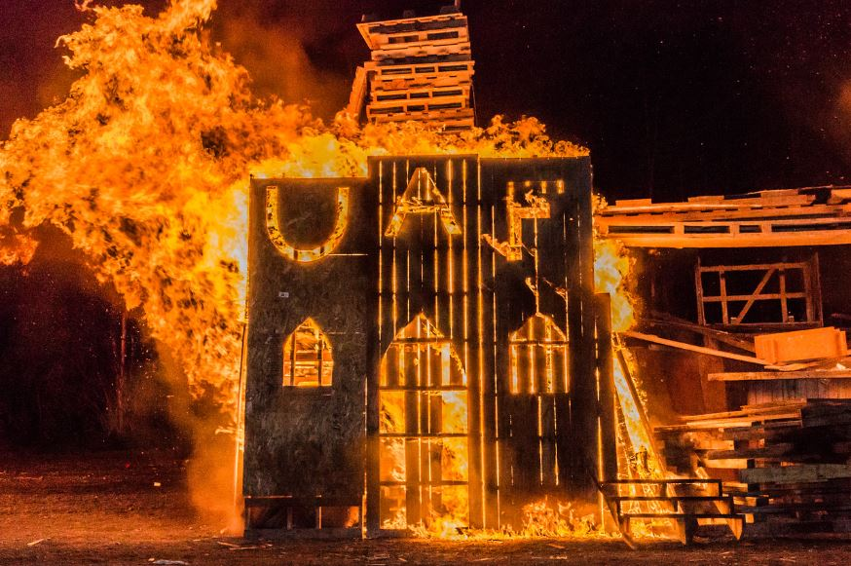
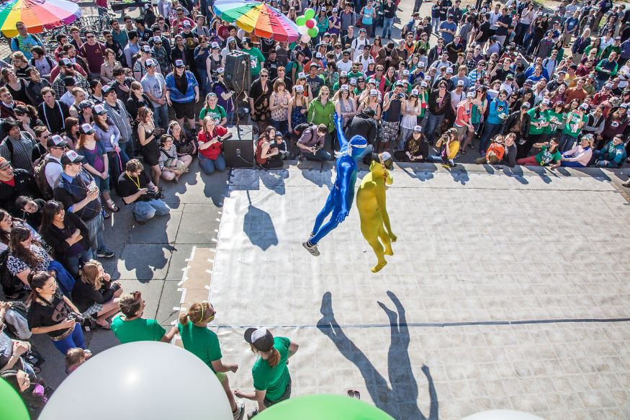
NANOOK TRADITIONS
Starvation Gulch
Founded in 1923, Starvations Gulch symbolizes the traditional passage of the torch of knowledge.
It’s a fierce competition between student organizations and departments on campus resulting in elaborate structures and bonfires.
Winter Carnival
Historically a celebration of the Governor's Cup hockey match, Winter Carnival is a way to break the cabin fever feelings of winter with invigorating and entertaining activities in February ranging from ice climbing to dog mushing and everything in between.
Springfest
Springfest celebrates the close of the academic year and return of the midnight sun.
Prominent events include Mud Volleyball, the Dance Off, Melon Drop, barbeque and SpringFest Service.

Slide 9
NANOOK RECREATION
Equipment rentals
Campus activities and events
Half-day to week long trips throughout Alaska
Summer trips include wilderness backpacking, day hikes, canoeing, sea kayaking, rock climbing and white water rafting
Winter trips include snowshoeing, cross country skiing, dog mushing, ice climbing, winter camping and cabin trips

Slide 10
